Slide 1

PRAYAS
EXPERIENCING THE HUMANE

Slide 2
Introduction
02
As seen there are many platforms available already in the market for e.g. Amazon.com is a vast Internet-based enterprise that sells books, music, movies, house wares, electronics, toys, and many other goods, either directly or as the middleman between other retailers and Amazon’s million customers. Its web services business includes renting data storage and computing resources, so-called “cloud computing,” over the Internet and many more,​such we want to introduce the system PRAYAS which is an open platform where we are eligible to donate our secondary or unused things to needy peoples with our choice of NGO’s. With a secured network and certified database of different NGO’s. Basically, PRAYAS is developing an open source system which comes under the agenda of helping and showing concerned with the humanities. PRAYAS is developing a system which is child centered and compassionate that revolves around civilized concern.

Slide 3
Abstract
03
PRAYAS is developing a system which is child centered and compassionate that revolves around civilized concern. Prayas​ can be a widely connected networking platform due to the connections it will form with NGO & ​OLD AGEHOMES​. In addition to​ theories of unemployment, the effects of unemployment within the economic system. Prayas​ provides employment too! Also, with secured network, Prayas​ will provide the payment gateways to the people with easy transactions. People will be able to donate money as well as to the NGO’S. A statistic will be monitored daily and maintained according to the transactions which will be happening every now and then. It will also help in determining the progress made so far. And due to this very transparency people will be more interested to give their inputs by relying on this initiative that provides with an open platform to billion people to help in a friendly manner.

Slide 4
Problem Statement
04
There are many platforms that are avail the opportunities by helping the people in need, but what Prayas has different from other resources is that it creates a genuine and an appropriate statistics of the donations by the people. It mainly focuses on D2R mechanism which is clearly obvious that the required facilities and goods shall only be received by the consumer (Old age homes and Orphanages) by maintaining the proper balance between the user and the consumer.

Slide 5
Presentation Overview
05
Scrum Methodology
Scrum Team
Scrum framework
Sprint
Scrum meetings
Artifacts Of Scrum
Scrum Review
KEY TOPICS

Slide 6
Diagrams undertaken
06
ER DIAGRAM
DFD LEVEL 0
DFD LEVEL 1
DFD LEVEL 2
PERT CHART
STATE CHART
STATE DIAGRAM
CLASS DIAGRAM
SEQUENCE DIAGRAM
DIAGRAMS

Slide 7
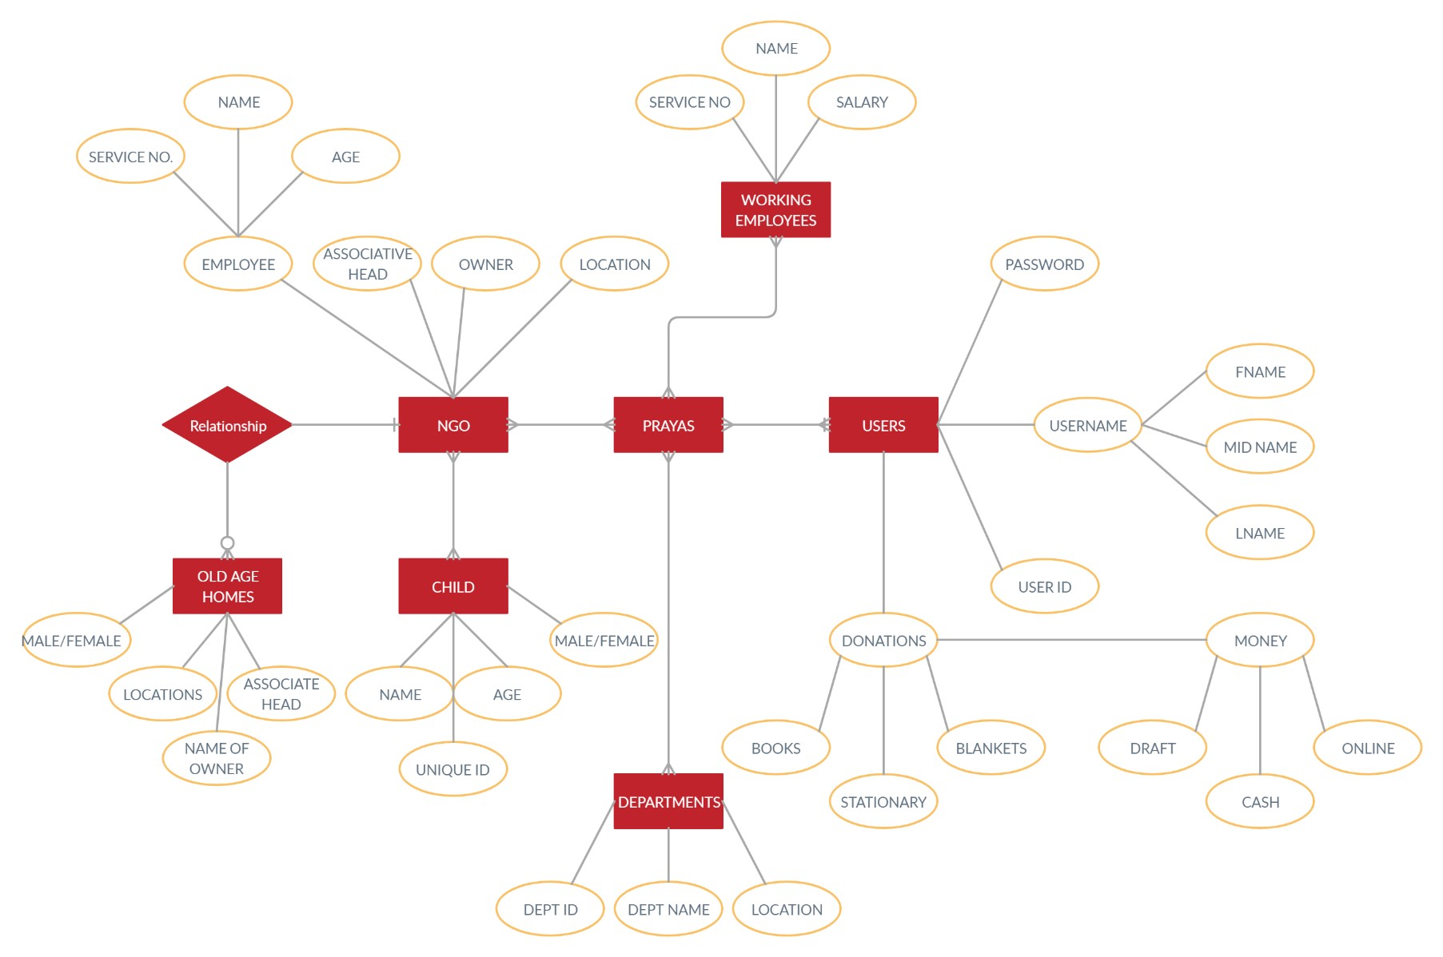
08
ER DIAGRAMS
07

Slide 8
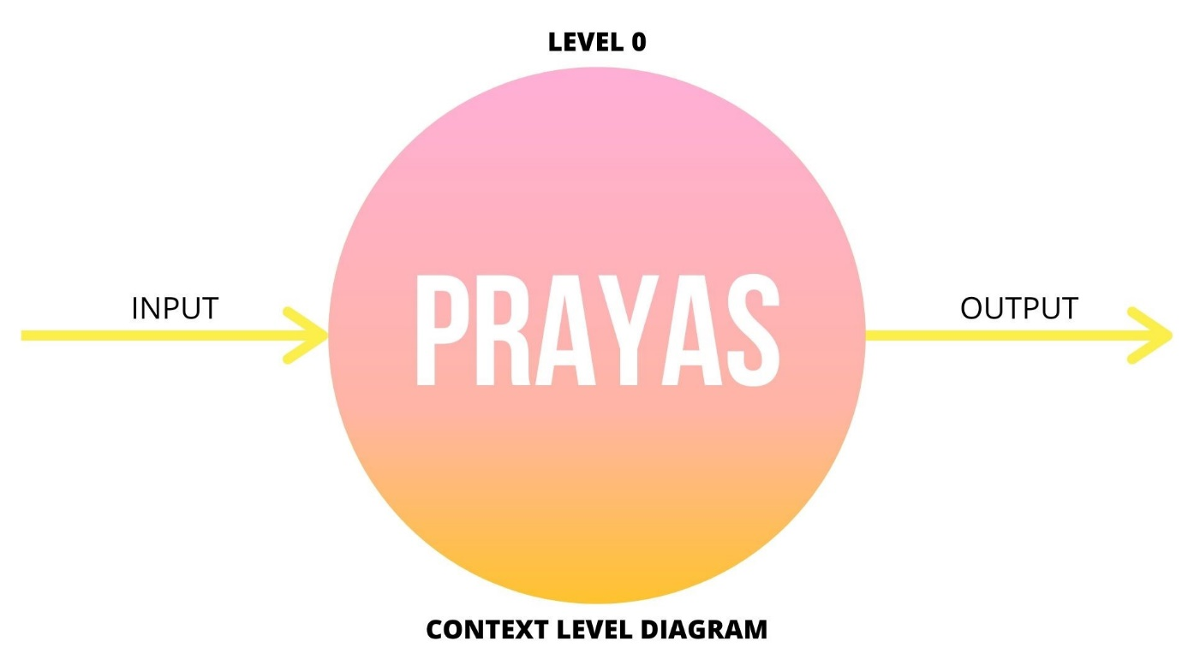
08
DATA FLOW DIAGRAMS LEVEL 0

Slide 9
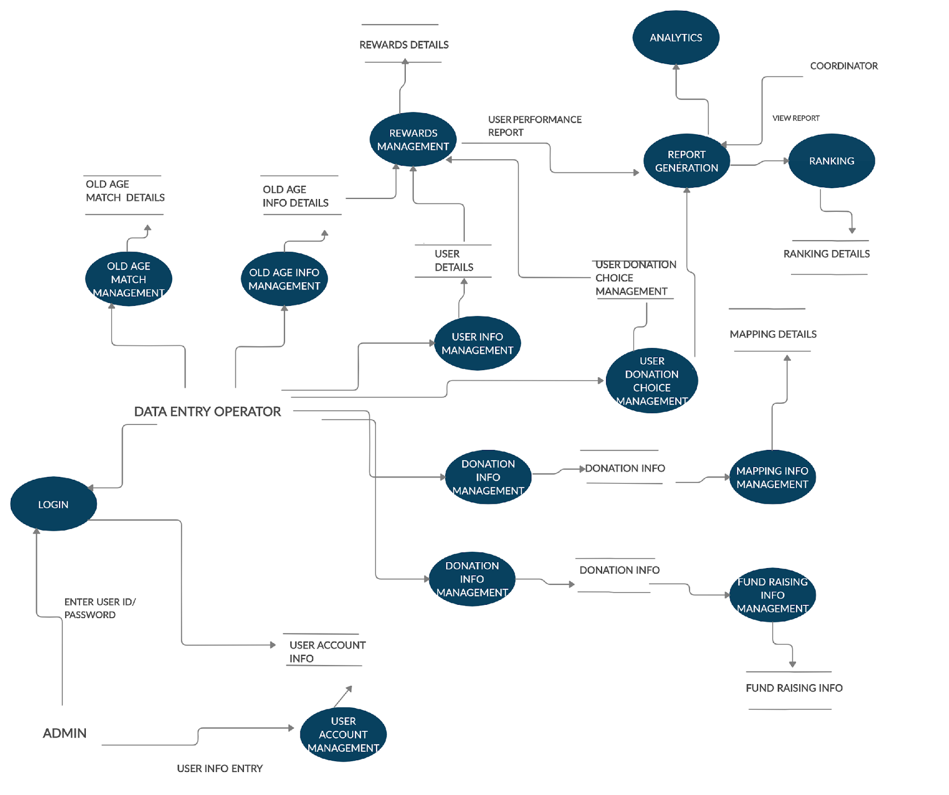
09
DATA FLOW
DIAGRAM
LEVEL 1

Slide 10
WE CAME ACROSS/IDENTIFIED
MAIN PROCESSES

Slide 11
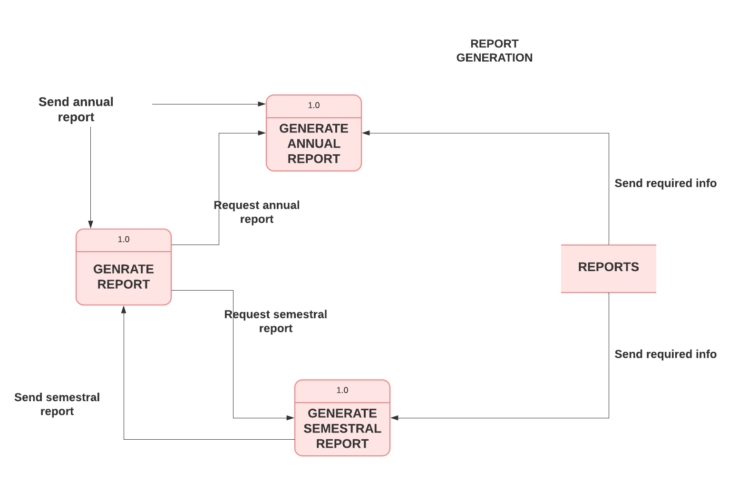
REPORT GENERATION
11

Slide 12
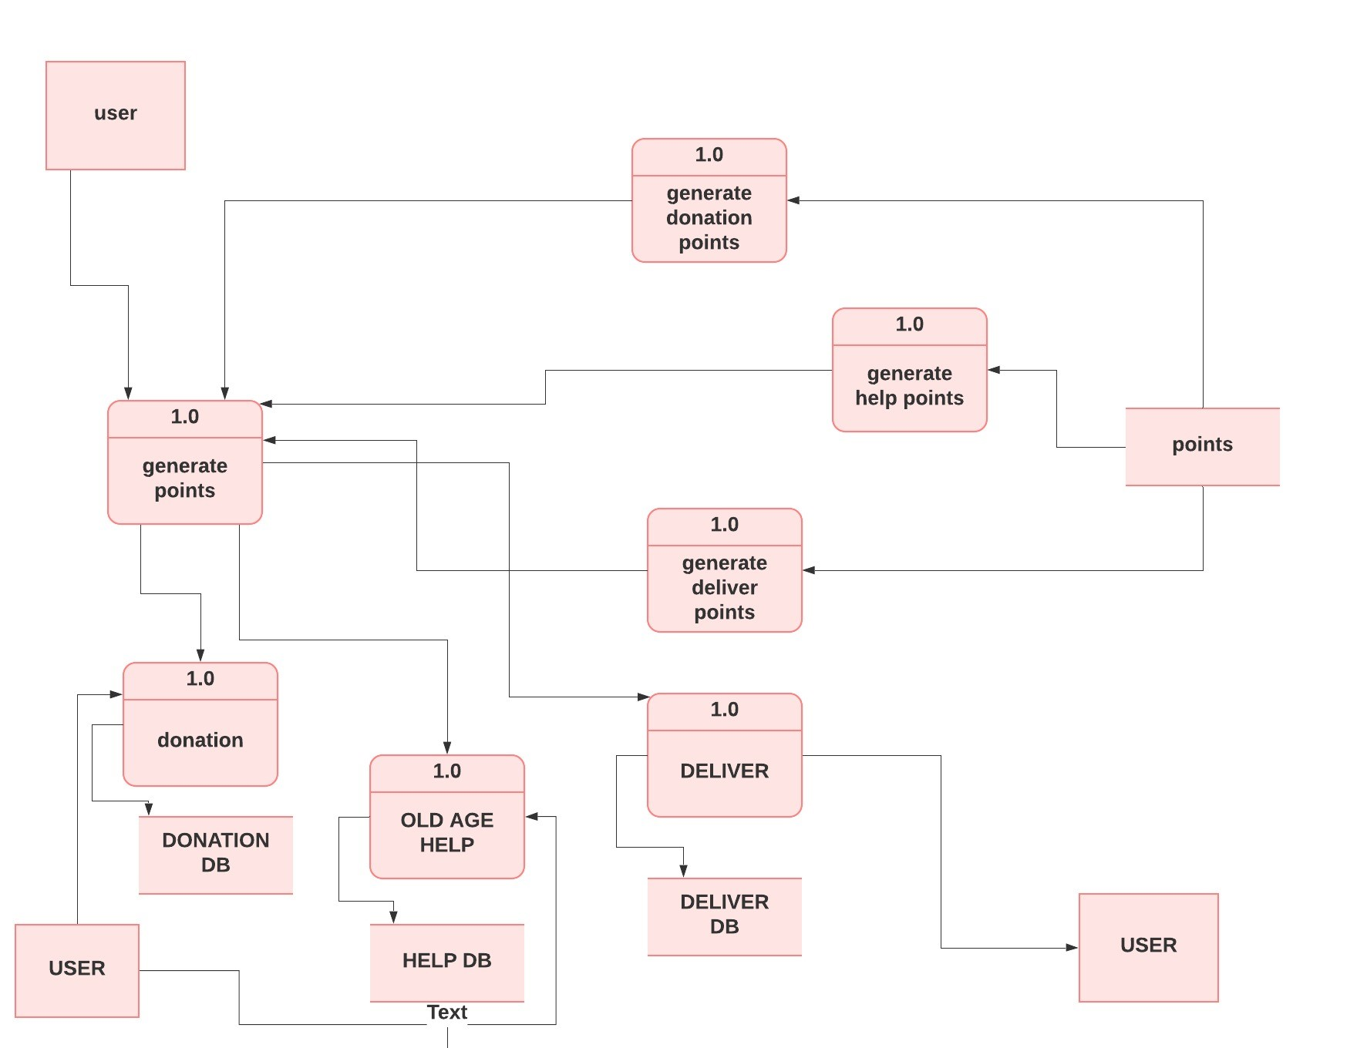
POINT GENERATION
12

Slide 13
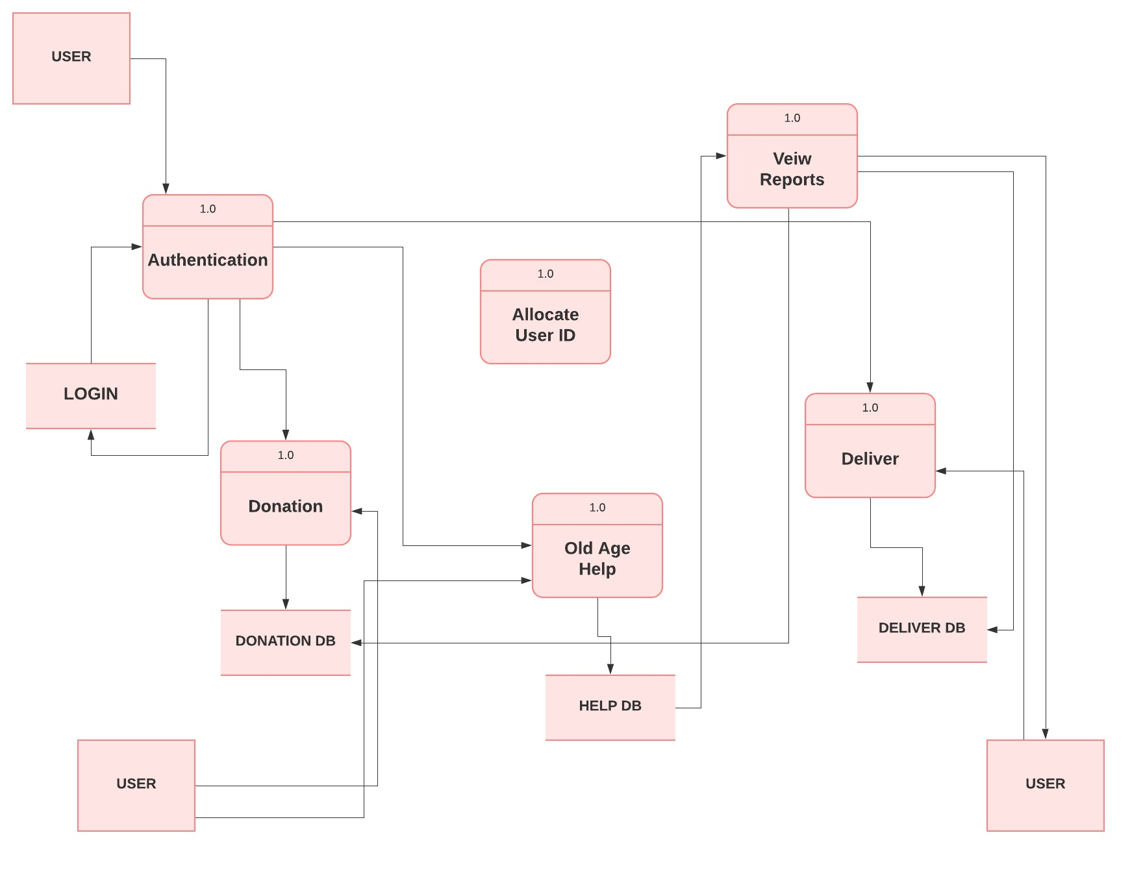
USER AUTHENTICATION
13

Slide 14
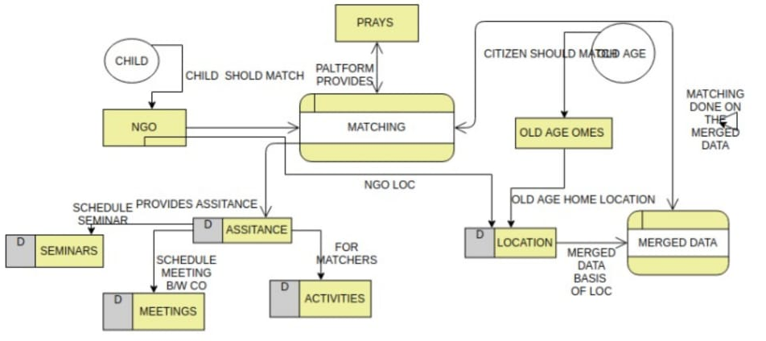
PROCESS MATCHING WITH OLD AGE
14

Slide 15
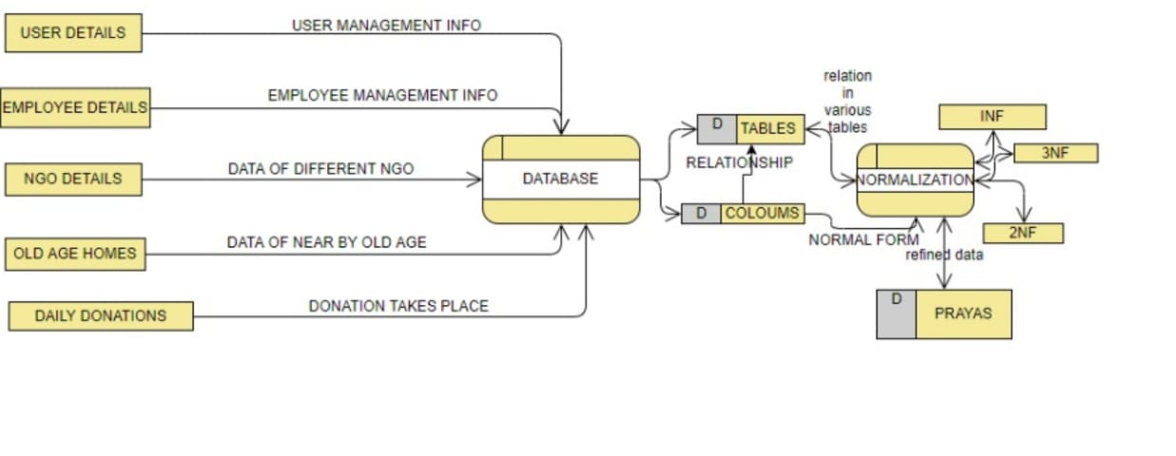
PROCESS DATABASE
15

Slide 16
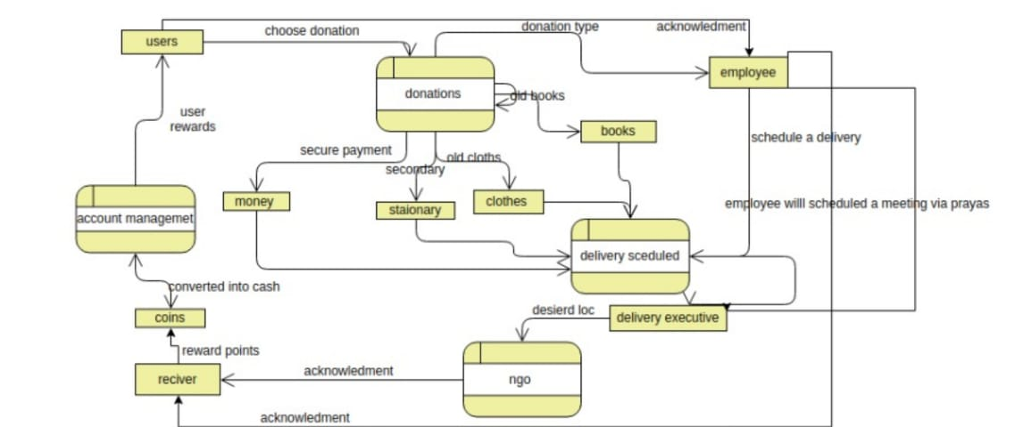
PROCESS DONATION
16

Slide 17
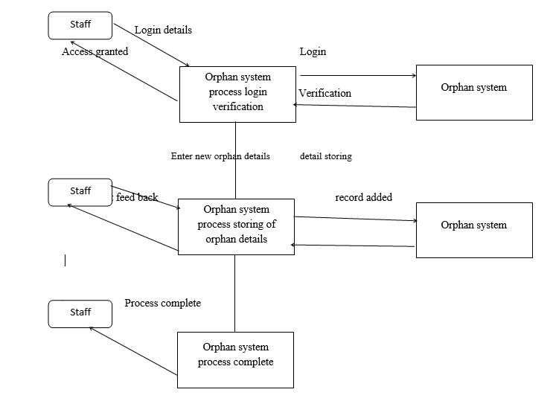
LOGIN PROCESS
17

Slide 18
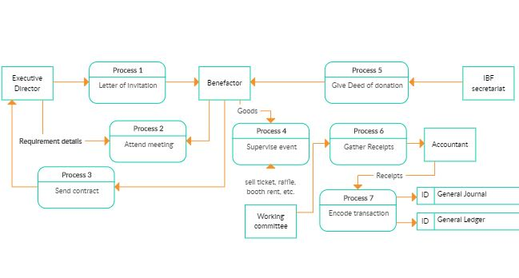
FUNDRAISING INFO MANAGEMENT
18

Slide 19
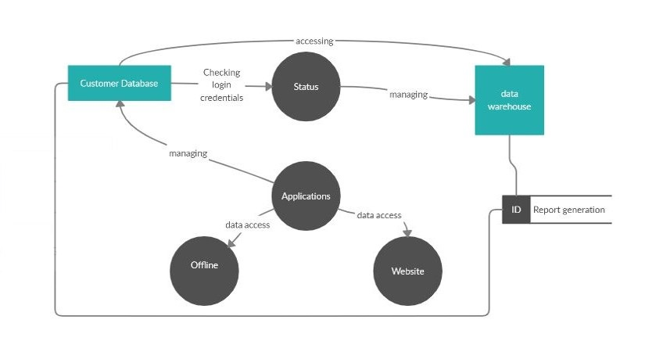
REPORT GENERATION
19

Slide 20
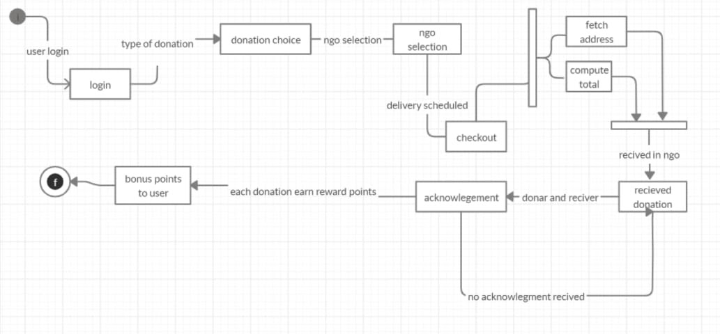
STATE CHART

Slide 21
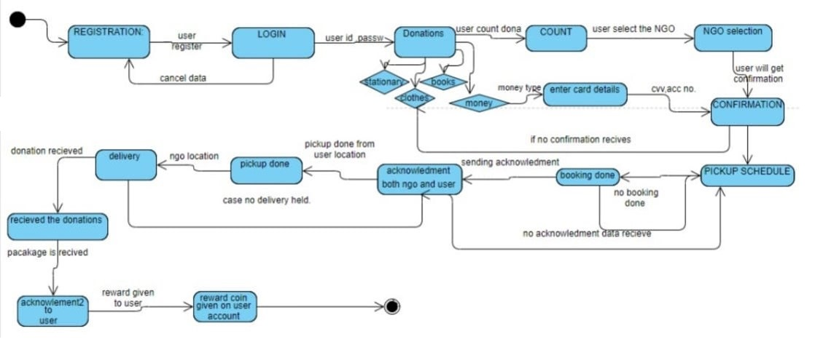
STATE DIAGRAM

Slide 22
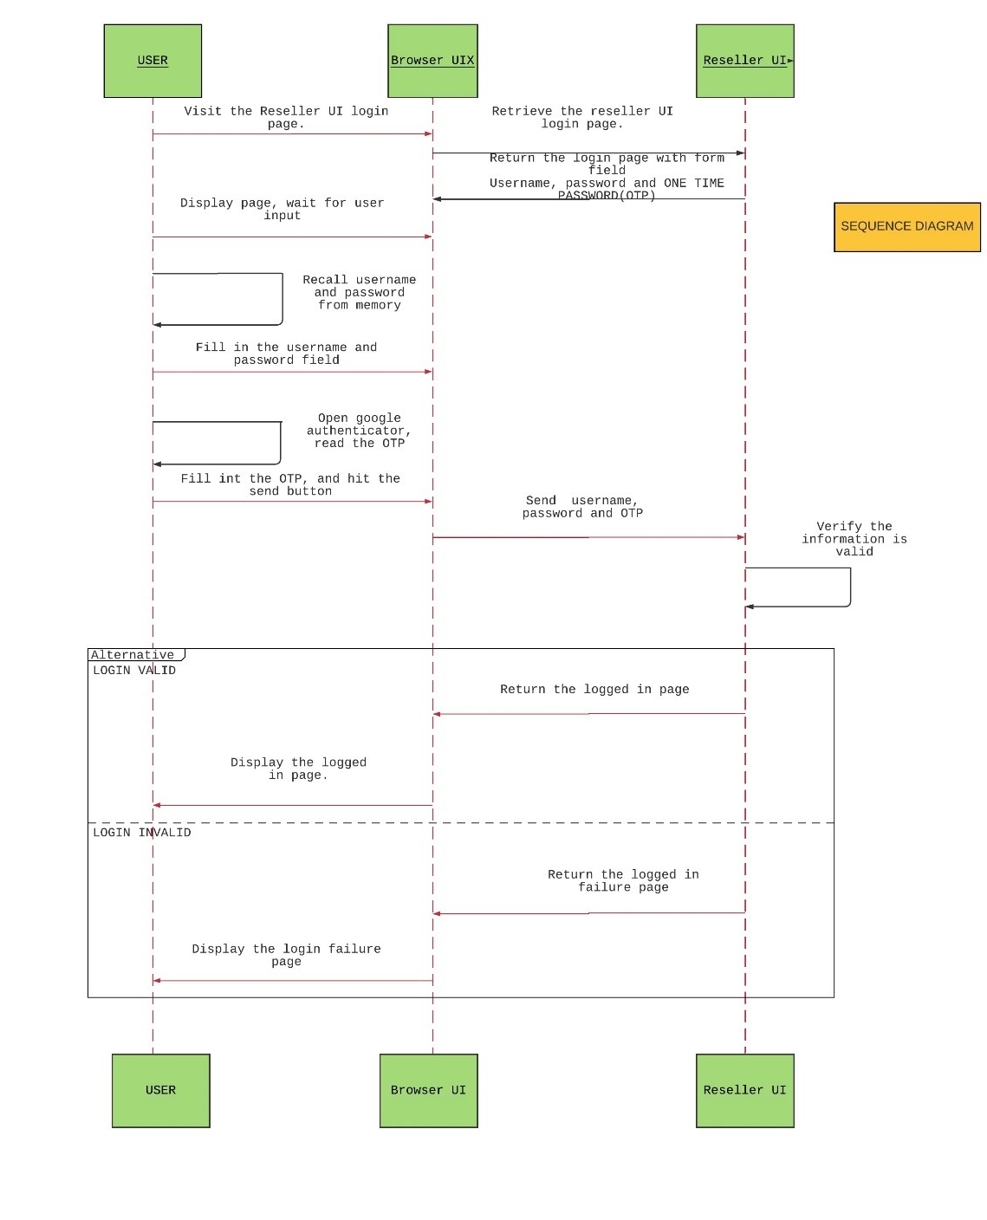
SEQUENCE
DIAGRAM
22

Slide 23
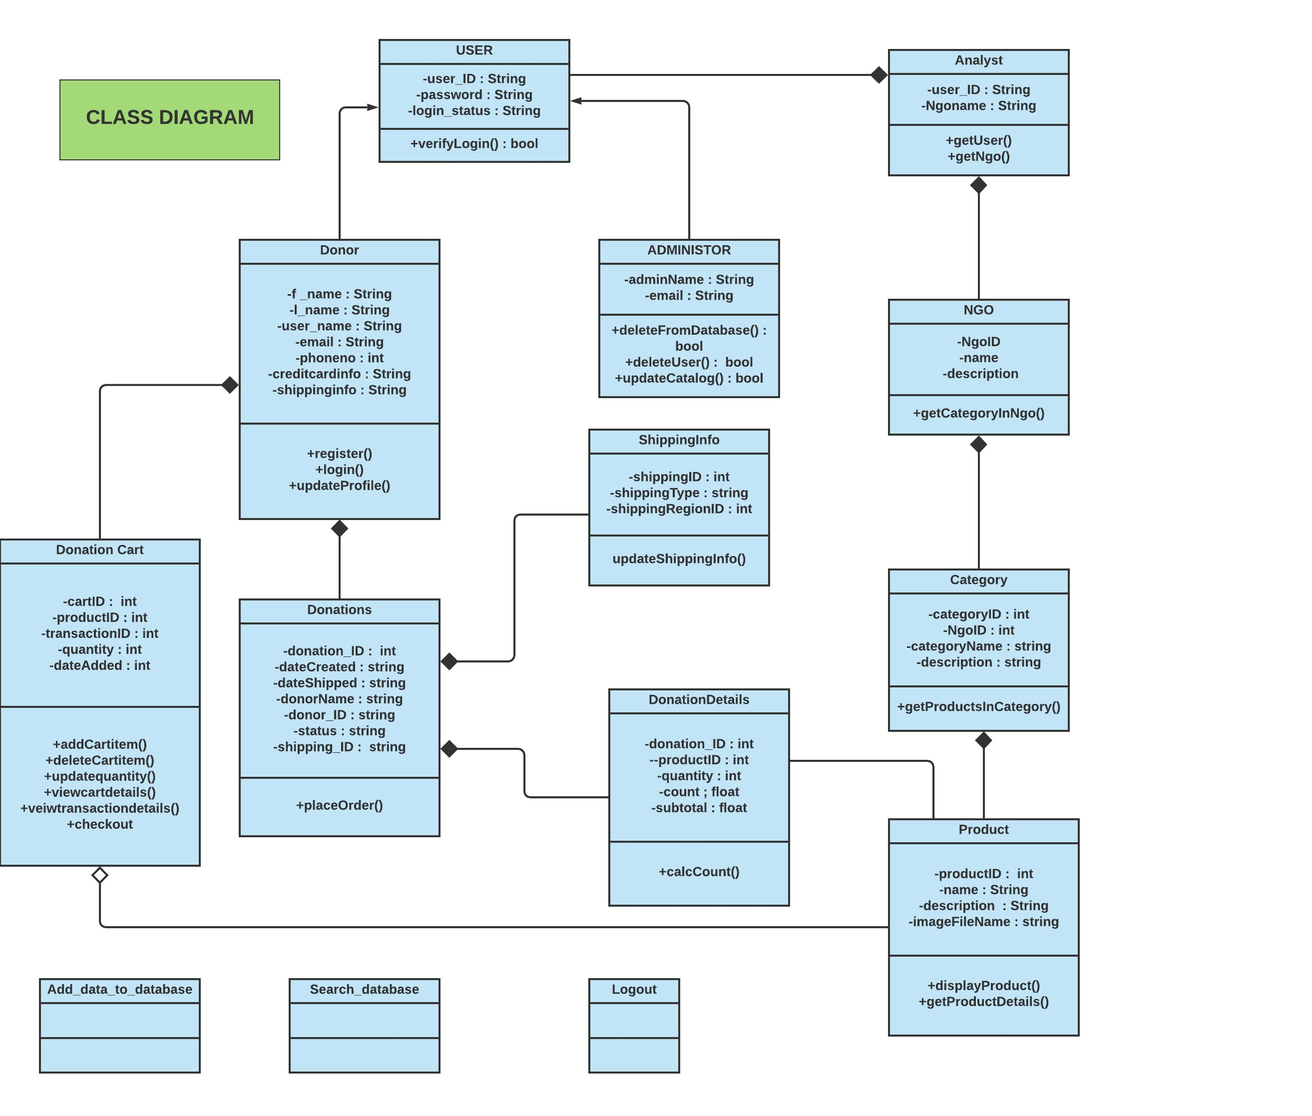
CLASS DIAGRAM
23

Slide 24
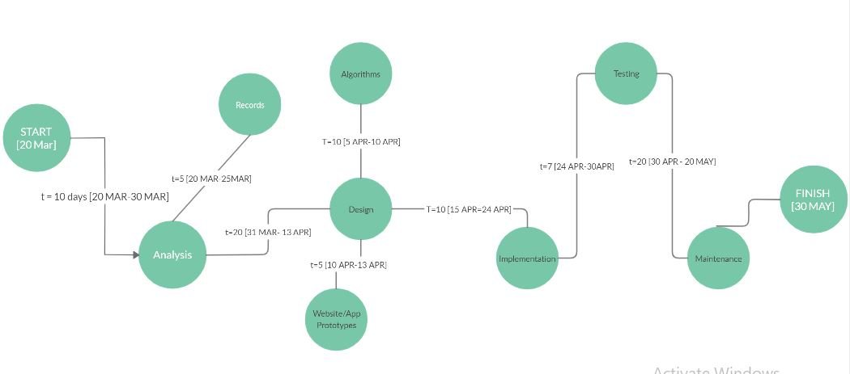
PERT CHART
24

Slide 25
SCRUM METHODOLOGY
25
Prayas in scrum methodology increasing in multiple iterations. The scrum framework encourages a high level of communication among team, so that team can follow what needs to be achieved. Our framework consists of scrum team, product owner, Scrum master. Each component within the framework serves a specific role which helpful in scrum development and usage

Slide 26
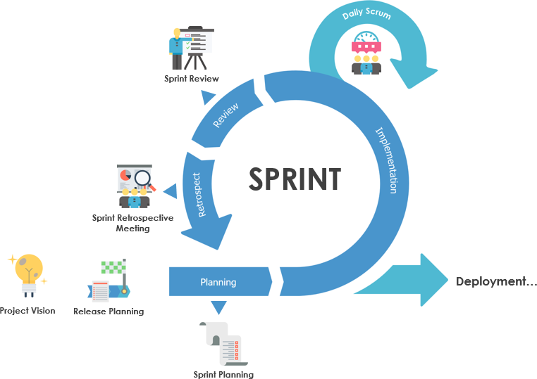
26

Slide 27
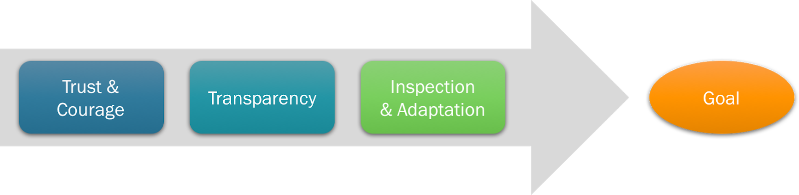
SPRINT
27
Product
Owner

Slide 28
SPRINT | TASK | TIME BOXED
1. | Collection of database of ngo,old age homes,from different websites focusing local areas. | 7 days
2. | Extracting data, draw diagrams on the basis of extracted data ,state diagram,statechart,sequence diagram,class diagram | 7 days
3. | Modifying the changes in the diagrams , evolving the teamwork understanding the abstract reviews | 3 days
4. | Comprehensive documentation of prays , using agile and waterfall methodology. | 4 days

Slide 29
29
DATE | TASK | TIMEBOXED
8-Apr-20 | Task divison,understanding work and flow | 15 min
9-Apr-20 | Sprint 1 discussion, work updates ,evaluation of each other's work. | 18 min
10-Apr-20 | print 1 rap up , update of diagrams,discussion on abstract reviews. | 12 min
11-Apr-20 | print 2 work update, more discussion on statechart ,class diagrams. | 17 min
12-Apr-20 | inalizing diagrams,discussion on documentation work | 15 min

Slide 30
SCRUM MEETINGS
30
Scrum meetings are an essential part of agile methodology. They are used to define the work for the day. These are short meetings, where team members talk about what has been done since the last scrum, what needs to be done and what problems need to be resolved.

Slide 31


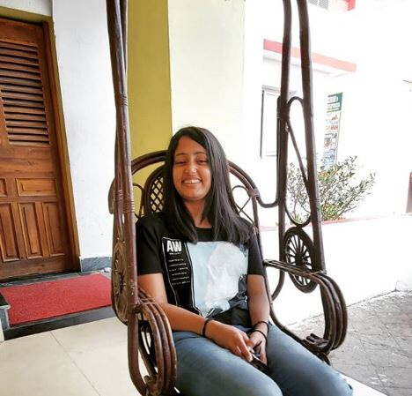
ARUSHI
SHAH
VATSALYA
TEGWAL
SURMAI
ADHIKARI
who are we?
Product Owner
Founder
Scrum
Master
Development
Team

Slide 32
Product Owner
32
The Scrum product owner job is to motivate the team with a clear, elevating goal. Team members know best what they are capable of, and so they select which user stories from the top of the product backlog they can commit to delivering during any sprint.the product owner makes a reciprocal commitment to not throw new requirements at the team during the sprint. Requirements are allowed to change (and change is encouraged) but only outside the sprint. Once the team starts on a sprint, it remains maniacally focused on the goal of that sprint. The product owner role requires working closely with key stakeholders throughout the organization and beyond, so he or she must be able to communicate different messages to different people about the project at any given time.

Slide 33
Scrum Master
33
Scrum master is known as guardian of Scrum Team, Scrum master helps in the proper functioning of the daily scrum meetings, sprint demo and retrospective meetings.Scrum master plays an important role of being a good coach in Agile practices. S/he can coach individuals and interactions over processes and tools. S/he helps in achieving the goals and helps in clarifying the aims and objectives individually as well. Scrum master has the Ability to shield his team from outside distractions and interferences due to which the team achieves the desired goal and they constantly focuses on working together and as a team.

Slide 34
Scrum Development Team
34
The Scrum team is a collection of individuals that works collectively together to deliver the required product output. The development team decides the strategy to accomplish the work set forth by the Product Owner. Development teams are structured and empowered to organize and manage their work.The scrum team drives the plan for each sprint. They discuss the timebox for each sprint, during which their work could be done. Development teams are cross-functional, with all the necessary skills required to create product increment.

Slide 35
Main artifacts of Scrum
35
05
The Scrum product owner job is to motivate the team with a clear, elevating goal. Team members know best what they are capable of, and so they select which user stories from the top of the product backlog they can commit to delivering during any sprint. The product owner makes a reciprocal commitment to not throw new requirements at the team during the sprint. Requirements are allowed to change (and change is encouraged) but only outside the sprint. Once the team starts on a sprint, it remains maniacally focused on the goal of that sprint. The product owner role requires working closely with key stakeholders throughout the organization and beyond, so he or she must be able to communicate different messages to different people about the project at any given time.

Slide 36
Why to use Scrum?
36
As per our project requirements, regular changes are required on the daily basis depending upon the information provided to us by the users.The main reason why we use this methodology is that the information database that we get from the registered user, needs to be updated, changed or modified depending upon the user’s daily contribution to the site. Frequent changes are needed for the users.

Slide 37
SCRUM REVIEW
37
Decided the sprints and time-boxed .
motivated team on each scrum meeting.
Work closely with development team
Come Up with strategies of how the product should get user attraction.

Slide 38
38
DATA MAINTENANCE
Customer data has to be managed regularly to prevent data duplication and providing maximum benefit.
Reasons to
use Scrum
Methodology
PROCESS IS LINEAR
Starts with requirements, leads to results, and stops
PROCESS IS CYCLIC
It repeats every Sprint, and planning for next Sprint overlaps with the work on the current Sprint

Slide 39

THANK YOU

